Slide 1
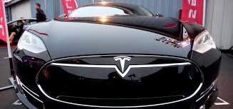
Environmental Scan

Slide 2
Introduction
In this presentation we present an environmental scan on Tesla Motors. We describe the internal and external analysis of the company. Tesla has created what is rapidly becoming a new standard for electric cars. By performing an environmental analysis, the company will be able to identify the external and internal conditions or elements that can affect the company.

Slide 3
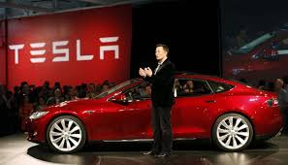
Environmental Scan
Purchasing Power
Guidelines of Distinct Official
Social Influences
Legal Regulations
Continual Improvements in technology

Slide 4
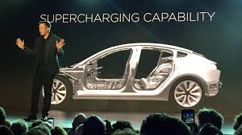
Strategy
Differential product strategies
Accumulation of the intellectual property
Developing the unique technologies
Identify the potential future needs

Slide 5
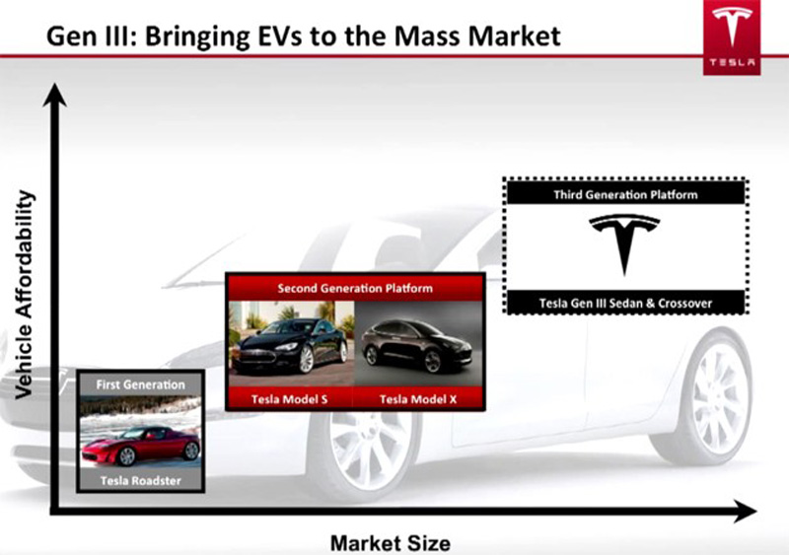
Internal Environment
Larger scale vehicle production for being competitive in the luxury EV segment.
Reputation for the quality
Keeps the overhead costs down

Slide 6
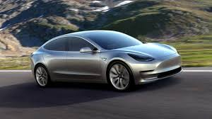
External Environment
Oil and fuel Fluctuations
Innovation and technological advancements.
Curing range anxiety and longevity
Competition
Self automated vehicles

Slide 7
External and Internal Analysis
The internal and external analysis is a helpful tool for decision making.
We take consideration on the quality of product while make decision in.
Tesla Motors Company. It is also helpful to reduce the cost.

Slide 8
Key issues
We learn various things by the internal and external analysis of the Tesla Motors.
We learn that what are the sources to make the company succeed.
The issue in this strategic planning is that various factors are responsible to apply the internal and external assessment tool in decision making
These assessments is a challenge for me to make decision in Tesla Motors

Slide 9
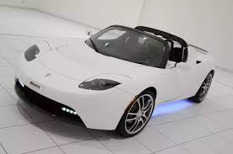
Initiative Plan
The Steering Committee will be responsible for the overall planning process, including the preparation of the final version of the strategic plan. The task forces will be responsible for identifying specific objectives and initiatives to pursue the strategic goals, determining the necessary resource requirements, proposing priorities, and recommending responsible individuals and timelines for next steps.

Slide 10
References
Gregory J. Metzger, P.-F. v. (2010). Performance of external and internal coil configurations for prostate investigations at 7 Tesla. Magn Reson Med.
Karamitsios, A. (2013). Open Innovation in EVs: A Case Study of Tesla Motors. Retrieved from http://www.diva-portal.org/smash/get/diva2:635929/FULLTEXT01.pdf
Praem, N. E. (2014). Valuation of Tesla Motors Inc. Copenhagen Business School.

